Slide 1
Lesson objective
PBiS Focus
Respect (listening)
Achieve (4 or 5 aim rating)
Title: Percent
Aim:
Apply mental strategies to determine 1%, 5% and 10% of amounts
Determine the percent of an amount
Plan:
Review conversions
Dividing by multiples of 10
Percent of amounts
Need whiteboards and calculators.

Slide 2
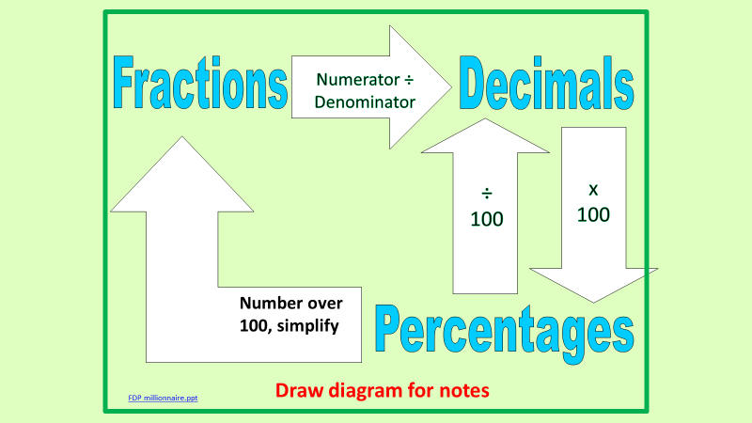
Daily review
Retrieve
Fraction
95/100
Decimal
0.2
0.35
Percent
70%
35%

Slide 3
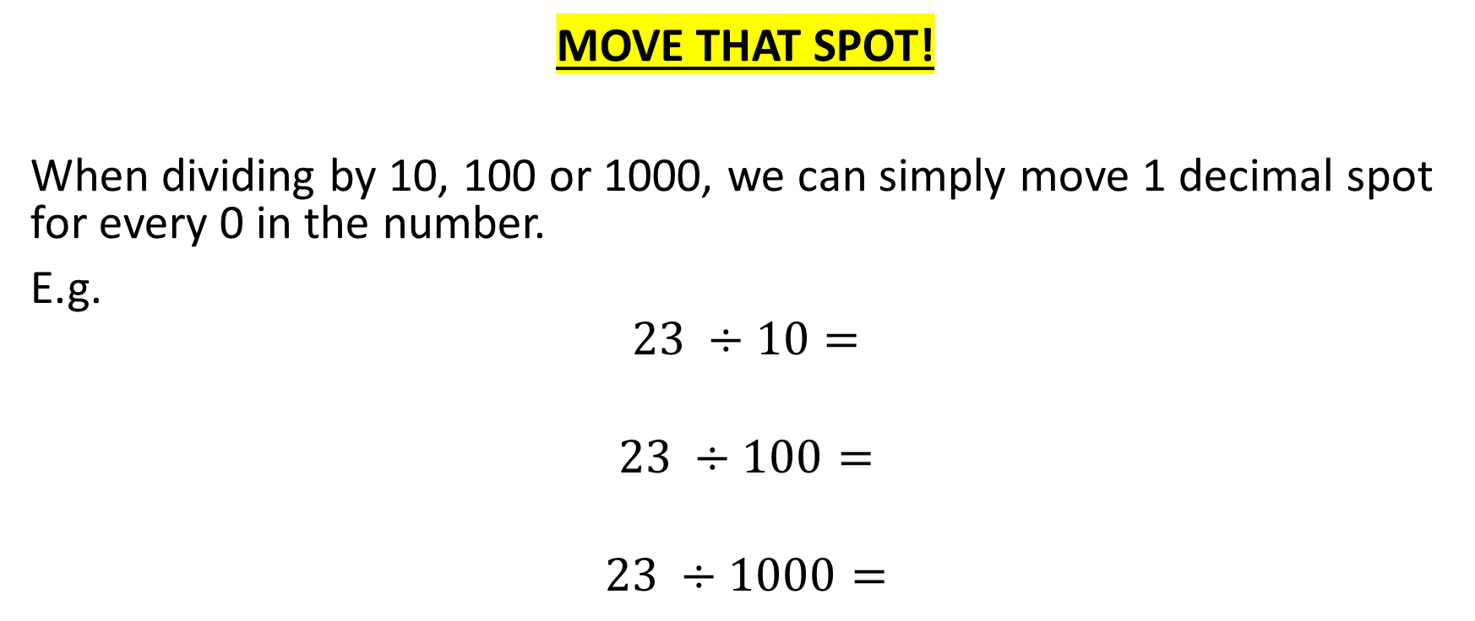
How many zero’s you got?
MOVE THAT SPOT!
When dividing by 10, 100 or 1000, we can simply move 1 decimal spot for every 0 in the number.
E.g.
$$23 ÷10=$$
$$23 ÷100=$$
$$23 ÷1000=$$

Slide 4
Whiteboards
Remember: how many zeros = number of spots to move
$$140 ÷10=$$
$$140 ÷100=$$
$$53 ÷10 =$$
$$5 ÷100=$$

Slide 5
Individual practice – Page 245
Not confident?
Confident?
Questions 1 – 12.
Start at question 5 go to 12.

Slide 6
Why was that important?
Well, when we need to find the percentage of something its handy to have these little tricks.
If I wanted 10% of $240
Well 10% ➔ $\frac{10}{100}$➔ simplifies to $\frac{1}{10}$
So the question is asking for $\frac{1}{10}$of $240
How many zero’s?
Move that spot
10% of $240 = $24

Slide 7
Examples
1% of 890
10% of 240
10% of 356
5% of 240
(find 10% then half it)
20% of 240
(find 10% and double it)

Slide 8
Problem solving
What if I wanted to find the percentage of an amount, but the percent was something tricky like…. 65% of 240?
What is a strategy I could use?
30 seconds, think pair and share.
A: build up from 50%+ 10% + 5% using the simple steps or take 35% from 240

Slide 9
Whiteboards
Find 10%, 5% and 1% of the following amounts
$80
120g
1500L
Find 85% of 160

Slide 10
Individual practice – Page 190
Not confident?
Confident?
Questions 1 – 12.
Start at question 5 go to 12.

Slide 11
Success check
Fist to five
Aim:
Apply mental strategies to determine 1%, 5% and 10% of amounts
Determine the percent of an amount

